Slide 1

Dallas Virtual
2nd Grade
Mrs. hannans
Room 306

Slide 2
Welcome!
We are so excited to have you back at school and back in our classroom!
This year may start a little different, but we couldn’t be happier to be back in the school and teaching!
Please click through the presentation and if you have any questions, you can email us or send us a message through ClassDojo.

Slide 3
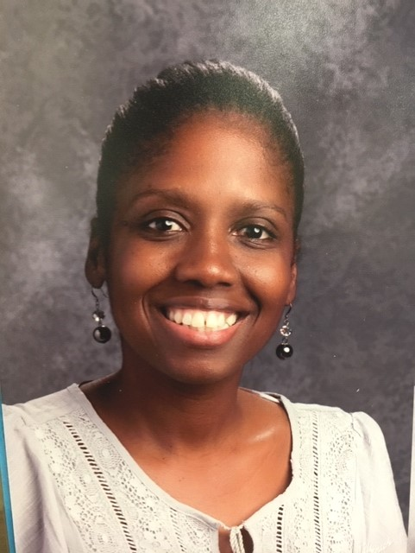
My name is Daphne Hannans. I am so excited to start my third year at Dallas Elementary School. This will be my 9th year of teaching. I taught second grade for 8 years and first grade for one year. It is going to be another great year at dallas elementary!

Slide 4
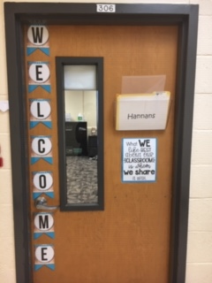
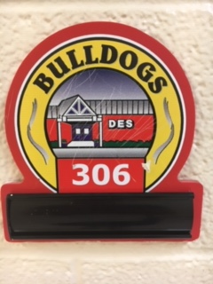
Our Room

Slide 5
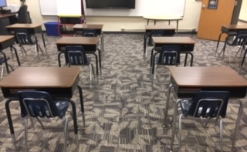
Our Room

Slide 6
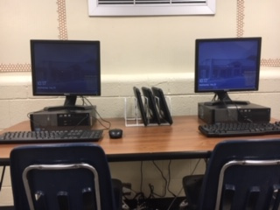
Our Room

Slide 7
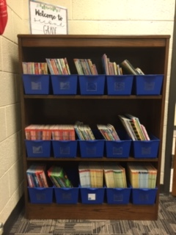
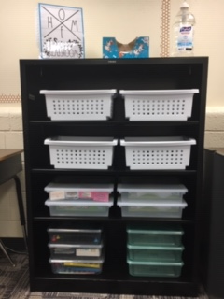
Our Room

Slide 8
Teacher webpage
We have created classroom webpages that list contact information along with other important links that you may need throughout the year.
Webpages can be accessed by going to the Dallas Elementary Homepage. Click on OUR STAFF and find your child’s teacher in the directory.
Below is the direct link to the Dallas homepage:
Dallas Elementary
Below is the direct link to my webpage:
Mrs.Hannans Homepage

Slide 9
2nd Grade
Blog
We have created a grade level blog with an abundance of resources and information.
Below is the direct link to the blog:
We Stick Together In Second Grade

Slide 10
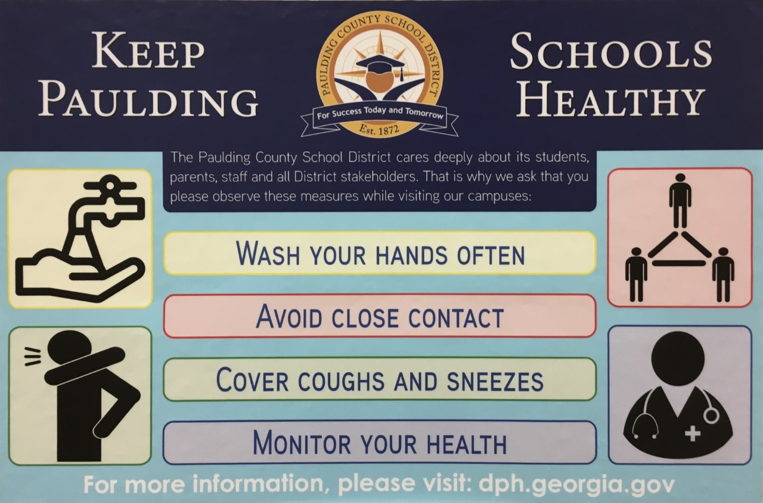
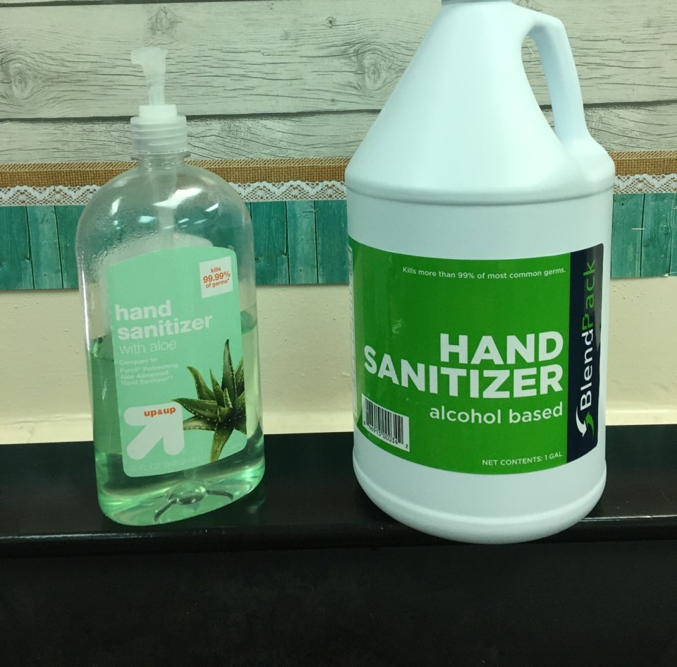
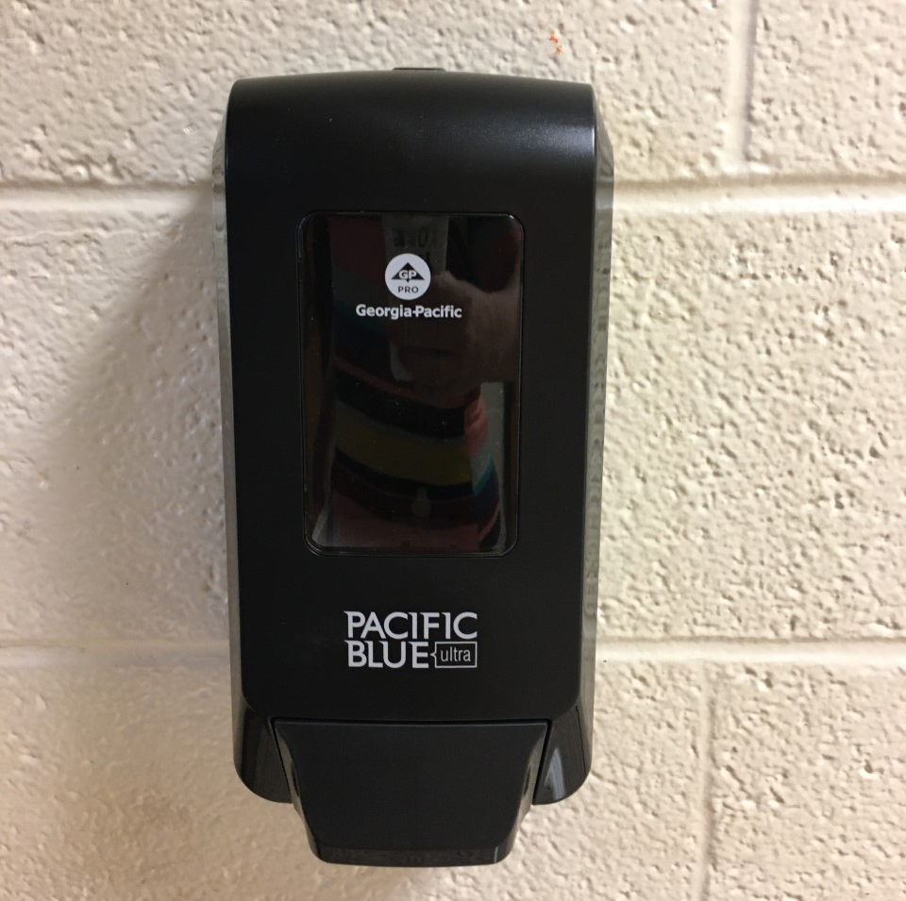
Safety
classrooms will have hand sanitizer for all students
classrooms will take scheduled breaks throughout the day to wash hands
we will wash hands before and after lunch

Slide 11







Stay healthy and be like a cactus

Slide 12
Visitors Policy
You will no longer be able to walk your child to class, bring items your child left at home, or eat lunch with students. Adults will not be allowed to enter the building past the front office.
We recognize this is a big change, but for the safety of all staff and students, this is a policy that will be enforced.

Slide 13
Schedule
7:25 - 8:00 Arrival- Capturing Kids Heart Greeting
8:00 - 8:10 Morning Meeting/ Good Things
8:10 – 8:55 Interactive Read Aloud/Writing
8:55 - 9:40 Math Workshop
9:40 – 9:45 Handwashing
9:50 – 10:05 Recess
10:10 – 10:40 Math NBI / Number Talks
10:45 – 11:25 SPECIALS
11:25 – 11:30 Handwashing

Slide 14
Schedule
Continued
11:30 – 11:50 Science / Social Studies
11:50-11:55 Bathroom/Handwashing
11:55 – 12:25 LUNCH
12:25 – 12:30 Bathroom/Handwashing
12:30 – 12:40 Number Talks
12:45 – 1:30 Shared Reading
1:30 – 2:15 Differentiated Instruction (DI)
2:15 – 2:20 Pack Up/Dismissal

Slide 15
Classroom procedures
Over the next few weeks, we will be reviewing and teaching the procedures that we will have in place for our classroom.
Please click the link below to view:
Classroom Policies

Slide 16
Email: dhannans@paulding.k12.ga.us
Class Dojo: Mrs. Hannans Class Dojo
(best method of contact)
Dallas Phone Number: 770-443-8018
Contact
Crayons – recommended Crayola 24 count
Tissues
Pencils – recommended Ticonderoga brand
Scissors
Glue Sticks (6)
Composition Notebook (5)
Spiralbound notebook with wide rule paper (1)
Large Pink Pearl erasers
2 pocket folders PLAIN COLOR (no prong)
Hand Sanitizer * Tissue
Supplies
Additional Supplies Appreciated
Colored Copy Paper
Disinfectant Wipes
Baby Wipes
Hand Sanitizer
Quart Size Ziplock Bags
Gallon Size Ziplock Bags
Pencils
Glue Sticks

Slide 17
 | * In order to be eligible, PLEASE fill out the APPLICATION online for the cafeteria * Reduced Breakfast $.30 * Reduced Lunch $.40
 | Children can purchase various ice cream/popsicle flavors each Friday for $1.00. The start date for this will be determined after school begins. This year we are asking parents to use REVTRAK for FROSTY FRIDAY money in order to prevent teachers from touching money. https://paulding.revtrak.net/elementary-schools/dallas-es/#/list
Cafeteria
Information
Breakfast: $1.40
Lunch: $2.15
Extra Milk: $.60
Free and Reduced
Breakfast/
Lunch
Frosty
Friday

Slide 18
Your child will have specials each day. A specials calendar will come home soon. The specials opportunities are p.e., music, art, media and STEM. When your child has p.e. he/she will need to wear tennis shoes.
Specials
Students will be able to have a snack DURING recess each day. This is a snack that you will provide from home. Please try to send in nutritious snacks if possible. Water is the only drink that is allowed. The water fountains may only be used to refill water bottles.
Snack/Water Bottles
We are not allowed to celebrate in the classroom. Parents will not be allowed to visit for lunch this year. If you would like your child to celebrate in school, please consider sending in a non-edible treat as outside food is restricted at this time.
Birthdays

Slide 19
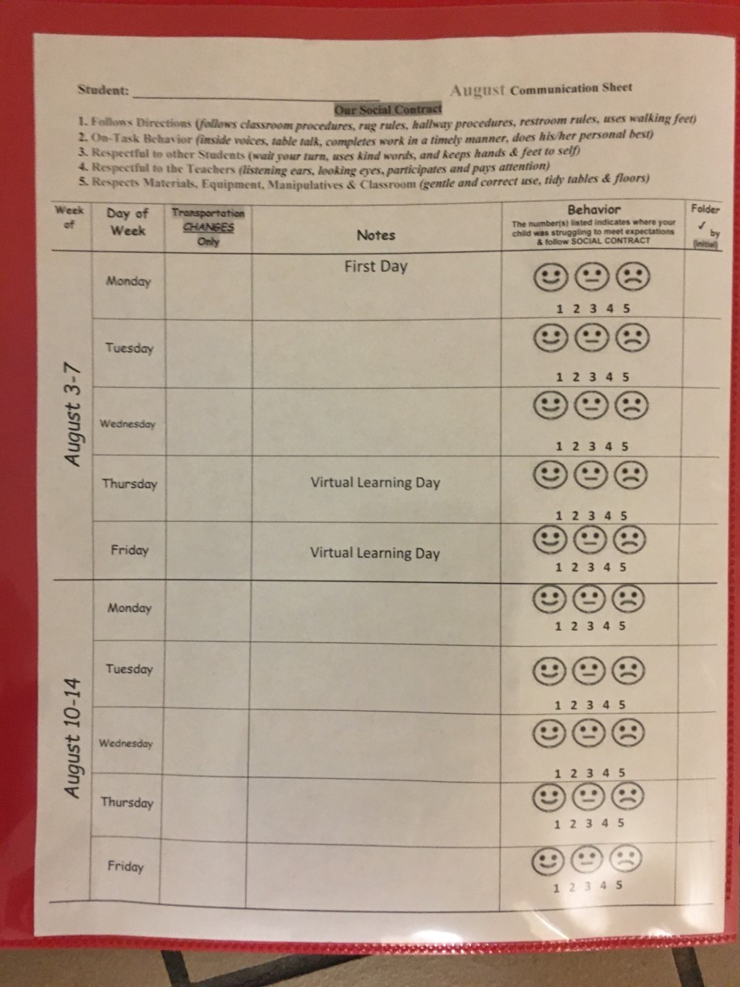

Behavior
Please review your child’s behavior chart daily. The number(s) circled/highlighted indicates where your child was struggling to meet expectations & follow the SOCIAL CONTRACT.
1 2 3 4 5

Slide 20

Open House
Forms
Please click on the Open House Forms below. This will take you to the electronic forms that you typically fill out during Open House.
Open House Forms

Slide 21

Thank You!
Thank you for joining our Virtual Open House!
We look forward to seeing you on Monday!

